Slide 1
Data Warehousing
Introduction

Slide 2
Data Warehouse
Data Warehousing
A subject-oriented, integrated, time-variant, non-updatable collection of data used in support of management decision-making processes
Subject-oriented: e.g. customers, patients, students, products
Integrated: consistent naming conventions, formats, encoding structures; from multiple data sources
Time-variant: can study trends and changes
Non-updatable: read-only, periodically refreshed

Slide 3
Data Warehouse
An ordinary Database can store MBs to GBs of data and that too for a specific purpose. For storing data of TB size, the storage shifted to Data Warehouse. Besides this, a transactional database doesn’t offer itself to analytics.
To effectively perform analytics, an organization keeps a central Data Warehouse to closely study its business by organizing, understanding, and using its historic data for taking strategic decisions and analyzing trends.

Slide 4
Advantages
Improved data quality: Data warehousing can help improve data quality by consolidating data from various sources into a single, consistent view.
Faster access to information: Data warehousing enables quick access to information, allowing businesses to make better, more informed decisions faster.
Better decision-making: With a data warehouse, businesses can analyze data and gain insights into trends and patterns that can inform better decision-making.
Reduced data redundancy: By consolidating data from various sources, data warehousing can reduce data redundancy and inconsistencies.
Scalability: Data warehousing is highly scalable and can handle large amounts of data from different sources.

Slide 5
Disadvantages
Cost: Building a data warehouse can be expensive, requiring significant investments in hardware, software, and personnel.
Complexity: Data warehousing can be complex, and businesses may need to hire specialized personnel to manage the system.
Time-consuming: Building a data warehouse can take a significant amount of time, requiring businesses to be patient and committed to the process.
Data integration challenges: Data from different sources can be challenging to integrate, requiring significant effort to ensure consistency and accuracy.
Data security: Data warehousing can pose data security risks, and businesses must take measures to protect sensitive data from unauthorized access or breaches.

Slide 6
Data Mart
A data mart is a scaled-down version of a data warehouse aimed at meeting the information needs of a homogeneous small group of end users such as a department or business unit.
It typically contains some form of aggregated data and is used as the primary source for report generation and analysis by this end user group.

Slide 7
OLTP vs OLAP
OLTP (Online Transaction Processing)
Captures, stores, processes data from transactions in real times
Used to control and run business operations
OLAP (Online Analytical Processing)
Uses complex queries to analyze aggregated historical data
Can use data from OLTP systems
Used to plan, solve problems, support decisions, discover hidden insights (Data Warehouse)

Slide 8
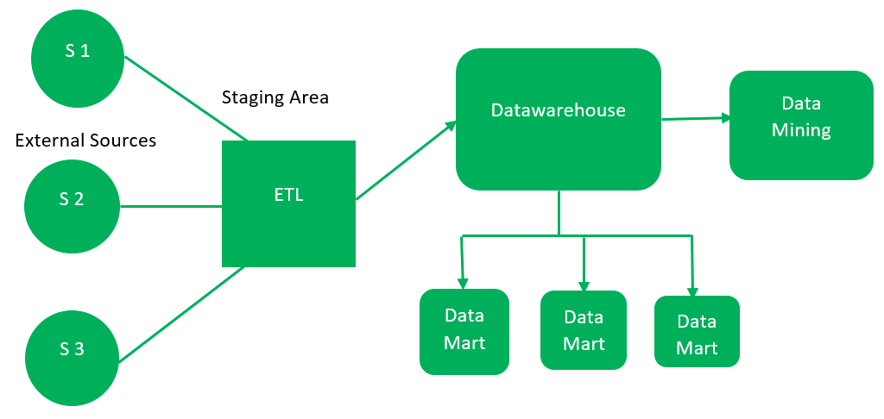
Architecture
Top-Down Approach (Inmon)

Slide 9
Architecture (Top-Down)
Data is collected from external sources
RDBMS, NoSQL DBs, Files, etc.
The stage area is where data is validated and put into a specific format. Recommended to use ETL tools
Extract, Transform, Load
After cleansing, data is stored in the data warehouse as the central repository
Data marts, as a scaled down version of the data, can be used by different business departments/teams
Data in the data warehouse can be analyzed to find patterns using data mining

Slide 10
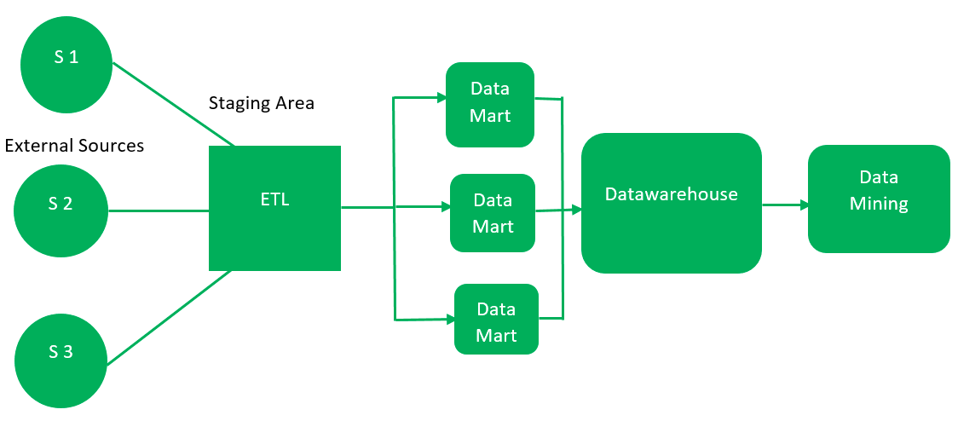
Architecture
Bottom-Up Approach (Kimball)

Slide 11
Architecture (Bottom-Up)
The ETL process for gathering and cleaning data is the same
After the staging area, data marts are created first.
The data marts are later integrated into a data warehouse for data mining purposes.

Slide 12
Inmon vs Kimball
 | Inmon (Top-Down) | Kimball (Bottom-Up)
Data Integration | It focuses on Enterprise-wide areas. | It focuses on Individual business areas.
Building Time | It is complex and consumes a lot of time. | It is efficient and takes less time.
Cost | Initial cost is huge and the development cost is low. | It has iterative steps and is cost-effective.
Skills Required | It needs specialized skills to make work. | It does not need such skills but a generic team will do the job.
Maintenance | Here maintenance is easy. | Here maintenance is difficult.
Data Model | It prefers data to be in a normalized model. | It prefers data to be in the De-normalized model.
Data Store Systems | In this, source systems have a high rate of change. | In this, source systems are highly stable.

Slide 13
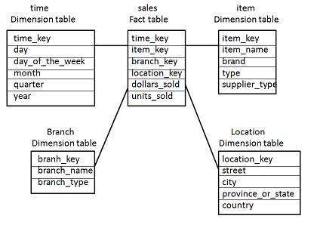
Schema
Star Schema

Slide 14
Star Schema
Fact table in the center. Contains keys to each of the dimension tables
Each dimension has only one dimension table and each holds a set of attributes

Slide 15
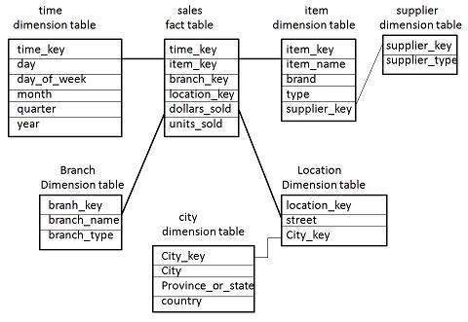
Schema
Snowflake Schema

Slide 16
Snowflake Schema
Fact table in the center.
One or more dimension tables are normalized
Thus, there may be more than one dimension table for each dimension in the fact table
Because dimension tables are normalized, there is a reduction in data redundancy, leading to saving storage

Slide 17
Data Lake
Data Lake
A centralized repository designed to store, process, and secure large amounts of structured, semistructured, and unstructured data
Can store data in its native format and process any variety of it

Slide 18
Types of Data
Structured
Known type and size
Data which can be stored in RDBMS
Semi-structured
Some organizational properties
XML, CSV
Unstructured
Not organized in a predefined manner or predefined data model
PDF, text file, videos

